Slide 1
数 据 库 原 理
Lecture 4
Intermediate SQL
王 建 民
清 华 大 学 软 件 学 院
2023年/春

Slide 2
Content
Join Expressions
Views
Transactions
Integrity Constraints
SQL Data Types and Schemas
Authorization
Notes:
1

Slide 3
From 子句中的连接操作
本节讨论SQL语言中笛卡尔积之外的附加链接操作
From r, s 等价于 From r cross join s
主要考虑以下两个方面：
A join operation is a Cartesian product which requires that tuples in the two relations match under some condition.
It also specifies the attributes that are present in the result of the join
These additional operations are typically used as subquery expressions(子查询) in the from clause

Slide 4
连接类型与条件
Join type (连接类型)
defines how tuples in each relation that do not match any tuple in the other relation based on the join condition are treated
Join condition(连接条件)
defines which tuples in the two relations match, and what attributes are present in the result of the join
Join Types
inner join
left
right outer join
full
Join Conditions
natural
on <predicate>
using (A1, A2, ..., An)

Slide 5
自然连接及其悬浮元组
已知：关系 loan 和 borrower
loan-number
branch-name
amount
customer-name
loan-number
L-170
L-230
L-260
Downtown
Redwood
Perryridge
3000
4000
1700
Jones
Smith
Hayes
L-170
L-230
L-155
Dangling Tuple
Dangling Tuple
loan natural join Borrower
loan-number
branch-name
amount
customer-name
L-170
L-230
Downtown
Redwood
3000
4000
Jones
Smith

Slide 6
内连接-自然连接的扩展
natural Join 的等价形式
loan natural inner join borrower
loan inner join borrower using(loan-number)
loan-number
branch-name
amount
customer-name
L-170
L-230
Downtown
Redwood
3000
4000
Jones
Smith
Inner join 的一般形式 inner theta join
loan inner join borrower on loan.loan-number = borrower.loan-number
loan-number
branch-name
amount
customer-name
loan-number
L-170
L-230
Downtown
Redwood
3000
4000
Jones
Smith
L-170
L-230

Slide 7
内连接-自然连接的扩展
Inner join 的一般形式 inner theta join
select count(distinct i1.id)
from instructor as i1 inner join instructor as i2 on i1.salary > i2.salary;
——拿非最低工资的教师人数
如果 select count(distinct id) from instructor和
select count(distinct salary) from instructor
的返回值都是50，那么上面语句的返回结果是多少？
如果count(distinct salry)是20，上面语句最少是多少？
Notes:
insert into instructor select replace(id,left(id,1),'A'),name,dept_name,salary from instructor

Slide 8
外连接
An extension of the inner join operation that avoids loss of information.
Computes the inner join and then adds tuples form one relation that does not match tuples in the other relation to the result of the join.
Uses null values.

Slide 9
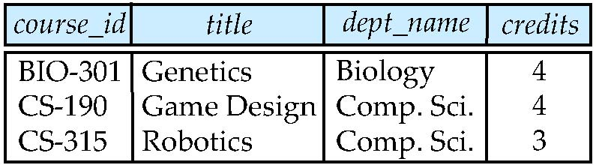
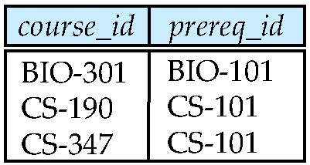
外连接操作举例
Relation course
悬浮元组
Relation prereq
悬浮元组
Observe that
prereq information is missing for CS-315 and
course information is missing for CS-437

Slide 10
外连接
left join 等价于 left outer join
select count(distinct i1.id)
from instructor as i1 left outer join instructor as i2 on i1.salary > i2.salary;
——拿非最低工资的教师人数
如果 select count(distinct id) from instructor和
select count(distinct salary) from instructor
的返回值都是50，那么上面语句的返回结果是多少？
如果count(distinct salry)是20，上面语句最少是多少？
Notes:
insert into instructor select replace(id,left(id,1),'A'),name,dept_name,salary from instructor

Slide 11
关系除法
Table PilotSkills (被除数) is about the pilots and the planes they can fly, table Hangar (除数) is about planes in the hangar,
we want the names of the pilots who can fly every plane (商) in the hangar.
Q=r ÷ s:
Relations r, s:
QX s:
A
B
B
A
A
B
1
2
α
β
α
α
β
β
1
2
1
2
α
α
α
β
γ
δ
δ
δ
β
1
2
3
1
1
1
3
4
2
s
r

Slide 12






PilotSkills和Hangar表定义
create table PilotSkills ( pilot varchar(20), plane varchar(20), primary key (pilot, plane));
create table Hangar ( plane varchar(20), primary key (plane));
PilotSkills
Hangar
pilot plane ========================= 'Celko' 'Piper Cub' 'Higgins' 'B-52 Bomber' 'Higgins' 'F-14 Fighter' 'Higgins' 'Piper Cub' 'Jones' 'B-52 Bomber' 'Jones' 'F-14 Fighter' 'Smith' 'B-1 Bomber' 'Smith' 'B-52 Bomber' 'Smith' 'F-14 Fighter' 'Wilson' 'B-1 Bomber' 'Wilson' 'B-52 Bomber' 'Wilson' 'F-14 Fighter' 'Wilson' 'F-117 Fighter'
plane ============= 'B-1 Bomber' 'B-52 Bomber' 'F-14 Fighter'

Slide 13
用Not Exists实现除法（1）
SELECT DISTINCT pilot FROM PilotSkills AS PS1 WHERE NOT EXISTS ((SELECT * FROM Hangar) except
(SELECT Plane FROM PilotSkills AS PS2 WHERE (PS1.pilot = PS2.pilot)));
所有机库中的飞机都在
该飞行员的技能列表中
R = {}
For PS1 in PilotSkills {
R1 = {}, R2 = {};
For t in Hanger {R1 = R1 U {t} };
For PS2 in PilotSkills {
if PS1.Pilot = PS2.Pilot then R2 = R2 U {PS2.plane} }
if R1 <= R2 then R = R U PS1.pilot;
}
Return R
Notes:
伪代码表示~

Slide 14
用Not Exists实现除法（2）
SELECT DISTINCT pilot
FROM PilotSkills AS PS1 WHERE NOT EXISTS (SELECT * FROM Hangar WHERE NOT EXISTS (SELECT * FROM PilotSkills AS PS2 WHERE (PS2.pilot = PS1.pilot) AND (PS2.plane = Hangar.plane)));
机库中飞机没有不在
该飞行员的技能列表中的
飞行员
不会开的飞机
R = {};
For PS1 in PilotSkills {
R1 = {};
For t in Hanger {
R2 = {};
For PS2 in PilotSkills {
if PS1.Pilot = PS2.Pilot and PS2.plane = Hanger.plane} then R2 = R2 U PS2}
if R2 <> {} then R1 = R1 U t;
}
if R1 = {} then R = R U PS1.pilot;
}
Return R

Slide 15
用Count实现除法（3）
SELECT DISTINCT pilot
FROM PilotSkills AS PS1 WHERE (SELECT count(DISTINCT plane) FROM Hangar WHERE plane in (SELECT plane FROM PilotSkills AS PS2 WHERE (PS2.pilot = PS1.pilot)))
=
(SELECT count(plane) From Hangar)
机库中的飞机都在
该飞行员的技能列表中的
飞行员

Slide 16
用Natural Join实现除法（4）
SELECT DISTINCT pilot
FROM PilotSkills AS PS1 WHERE (SELECT count(DISTINCT plane)
FROM PilotSkills as PS2 natural join Hangar
where PS2.pilot = PS1.pilot) =
(SELECT count(plane) From Hangar)
机库中的飞机都在
该飞行员的技能列表中的
飞行员

Slide 17
整除的关系除法
Table PilotSkills (被除数) is about the pilots and the planes they can fly, table Hangar (除数) is about planes in the hangar,
we want the names of the pilots (商) who must have the same number of certificates as there planes in the hangar, not something else.

Slide 18
用Left Outer Join实现除法（5）
SELECT PS1.pilot FROM PilotSkills AS PS1 LEFT OUTER JOIN Hangar AS H1 ON PS1.plane = H1.plane
GROUP BY PS1.pilot HAVING
COUNT(PS1.plane) = (SELECT COUNT(plane) FROM Hangar) AND COUNT(H1.plane) = (SELECT COUNT(plane) FROM Hangar);
PilotSkills
pilot plane ========================= 'Celko' 'Piper Cub' 'Higgins' 'B-52 Bomber' 'Higgins' 'F-14 Fighter' 'Higgins' 'Piper Cub' 'Jones' 'B-52 Bomber' 'Jones' 'F-14 Fighter' 'Smith' 'B-1 Bomber' 'Smith' 'B-52 Bomber' 'Smith' 'F-14 Fighter' 'Wilson' 'B-1 Bomber' 'Wilson' 'B-52 Bomber' 'Wilson' 'F-14 Fighter' 'Wilson' 'F-117 Fighter'
plane ============= 'B-1 Bomber' 'B-52 Bomber' 'F-14 Fighter‘
Hangar

Slide 19
Content
Join Expressions
Views
Transactions
Integrity Constraints
SQL Data Types and Schemas
Authorization
Notes:
1

Slide 20
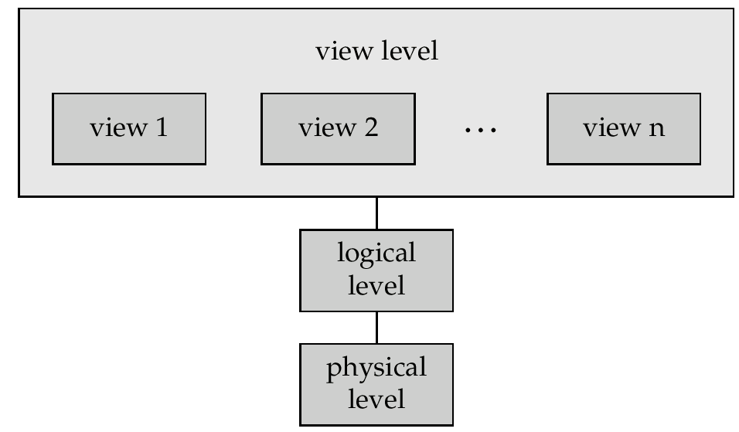
数据抽象
End User
Programmer
Administrator

Slide 21
视图
In some cases, it is not desirable for all users to see the entire logical model (that is, all the actual relations stored in the database.)
A view provides a mechanism to hide certain data from the view of certain users.
Any relation that is not of the logical model but is made visible to a user as a “virtual relation” is called a view.

Slide 22
理解视图
视图是一种虚表，它依赖数据库表而存在，这个数据库表也称为实表
视图是供程序员或最终用户使用数据库的一个窗口
视图提供了独立于实表的，数据逻辑独立性；它与数据的物理独立性相对应。

Slide 23
视图定义
A view is defined using the create view statement which has the form
create view v as < query expression >
where <query expression> is any legal SQL expression. The view name is represented by v.
Once a view is defined, the view name can be used to refer to the virtual relation that the view generates.

Slide 24
Create & Drop View
create view Perryridge-branch as select branch-name, assets from branch
where branch-city = ‘Perryridge’
The drop view command deletes the view definition from the database
Drop view Perryridge-branch
Drop view Perryridge-branch CASCADE

Slide 25
视图举例
A view of instructors without their salary create view faculty as select ID, name, dept_name from instructor
Find all instructors in the Biology department select name from faculty where dept_name = 'Biology’
Create a view of department salary totals create view departments_total_salary(dept_name, total_salary) as select dept_name, sum (salary) from instructor group by dept_name;

Slide 26
视图调用视图
create view physics_fall_2009 as select course.course_id, sec_id, building, room_number from course, section where course.course_id = section.course_id and course.dept_name = ’Physics’ and section.semester = ’Fall’ and section.year = ’2009’;
create view physics_fall_2009_watson as select course_id, room_number from physics_fall_2009 where building= ’Watson’;

Slide 27
From子句中视图展开
create view physics_fall_2009_watson as
select course_id, room_number
from (select course.course_id, building, room_number
from course, section
where course.course_id = section.course_id
and course.dept_name = ’Physics’
and section.semester = ’Fall’
and section.year = ’2009’)
where building= ’Watson’;

Slide 28
视图层次展开算法
View expansion of an expression repeats the following replacement step:
repeat Find any view relation v_{i} in e₁ Replace the view relation v_{i} by the expression defining v_{i} until no more view relations are present in e₁
As long as the view definitions are not recursive, this loop will terminate

Slide 29
视图更新
Add a new tuple to faculty view which we defined earlier
insert into faculty values ('30765', 'Green', 'Music');
This insertion must be represented by the insertion of the tuple
('30765', 'Green', 'Music', null)
into the instructor relation

Slide 30
视图二义性操作
create view instructor_info as select ID, name, building from instructor, department where instructor.dept_name= department.dept_name;
insert into instructor_info values ('69987', 'White', 'Taylor');
which department, if multiple departments in Taylor?
what if no department is in Taylor?

Slide 31
视图更新的条件
Most DBMSs allow updates only on simple views
The from clause has only one database relation.
The select clause contains only attribute names of the relation, and does not have any expressions, aggregates, or distinct specification.
Any attribute not listed in the select clause can be set to null
The query does not have a group by or having clause.

Slide 32
Content
Join Expressions
Views
Transactions
Integrity Constraints
SQL Data Types and Schemas
Authorization
Notes:
1

Slide 33
事务操作
Atomic transaction
Unit of work
either fully executed or rolled back as if it never occurred
Isolation from concurrent transactions
Transactions begin implicitly
Ended by commit work or rollback work
But default on most databases: each SQL statement commits automatically
Can turn off auto commit for a session (e.g. using API)
In SQL:1999, can use: begin atomic …. end
Not supported on most databases

Slide 34
SQL-92中事务的一致性级别
Serializable — default
Repeatable read — only committed records to be read, repeated reads of same record must return same value. However, a transaction may not be serializable – it may find some records inserted by a transaction but not find others.
Read committed — only committed records can be read, but successive reads of record may return different (but committed) values.
Read uncommitted — even uncommitted records may be read.
Set transaction isolation level serializable

Slide 35
基于HSQLDB的实验
transfer $500 from the account balance of A to the account balance of B.
create table account( account_number char(10) primary key,
branch_name varchar(20), balance numeric(12,2));
Insert into account values ('A', 'THU', 1000);
Insert into account values ('B', 'PKU', 1000);
启动HSQLDB 服务器，启动客户端 Client 1 ，关掉AutoCommit选项，启动Client 2
Client 1
Update account set balance = balance - 500
Where account_number = 'A';
Update account set balance = balance + 500
Where account_number = 'B';
Client 2
Select sum(balance) from account Where account_number in ('A', 'B');
START TRANSACTION
ROLLBACK
Select sum(balance) from account Where account_number in ('A', 'B');
COMMIT

Slide 36
Content
Join Expressions
Views
Transactions
Integrity Constraints
SQL Data Types and Schemas
Authorization
Notes:
1

Slide 37
完整性约束
Integrity constraints guard against accidental damage to the database, by ensuring that authorized changes to the database do not result in a loss of data consistency
Examples:
A checking account must have a balance greater than $10,000.00
A salary of a bank employee must be at least $4.00 an hour
A customer must have a (non-null) phone number

Slide 38
单表上的约束
not null
branch_name char(15) not null,
primary key
branch_name char(15) primary key,
unique
check (P ), where P is a predicate

Slide 39
唯一性约束-Unique Constraint
The unique specification states that the attributes, A1, … Am, forms a candidate key
Candidate keys are permitted to be null (in contrast to primary keys)
create table department
(dept_name varchar (20),
building varchar (15),
budget numeric (12,2),
unique (dept_name));
create table department
(dept_name varchar (20),
building varchar (15),
budget numeric (12,2),
primary key(dept_name));
这两个语句有什么区别？
Notes:
create table aa (a1 int primary key, a2 int unique);
create table bb (b1 int primary key, b2 int unique references aa);

Slide 40
Check子句
check (P ), where P is a predicate
create table branch (branch_name char(15), branch_city char(30), assets integer, primary key (branch_name), check (assets >= 0))
说明营业所资产assets不能为负值，branch_name不能为空

Slide 41
Check子句举例
create table branch (branch_name char(15), branch_city char(30), assets integer, primary key (branch_name), check (assets >= 0))
Insert into branch values(‘TS’, null, -10);
Insert into branch values(‘TS’, null, 10);
Insert into branch values(‘TS’, ‘BJ’, 0);

Slide 42
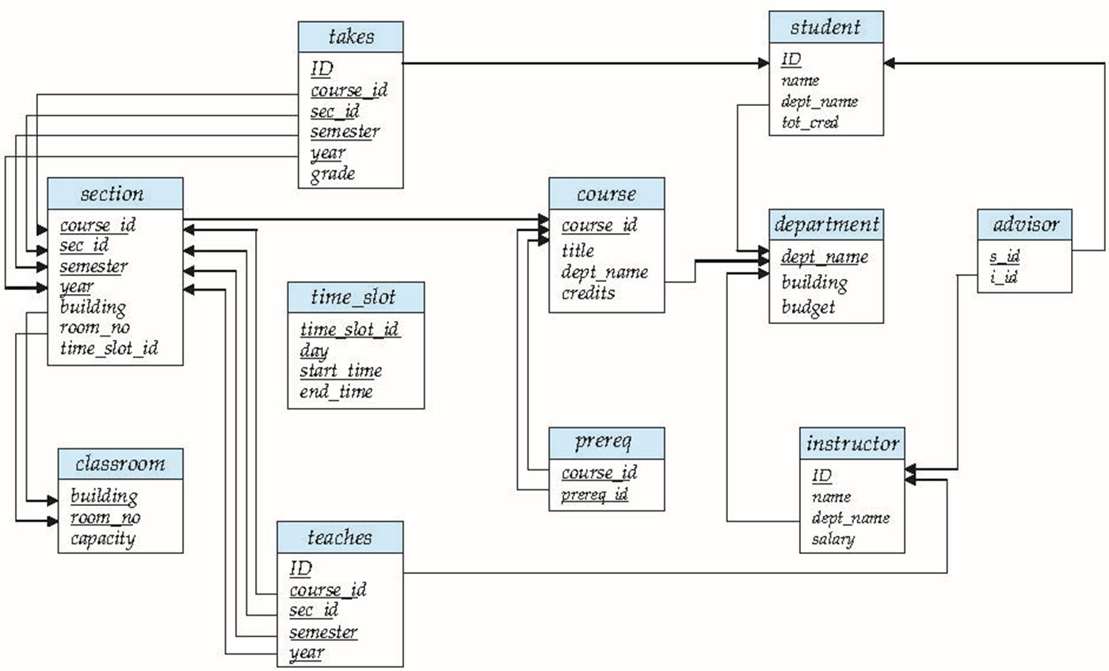
复杂Check子句
check (time_slot_id in (select time_slot_id from time_slot))
why not use a foreign key here?

Slide 43

参照完整性
外键约束，即两个关系之间属性取值的约束
Ensures that a value that appears in one relation for a given set of attributes also appears for a certain set of attributes in another relation
?(“Perryridge”, …, …)
(A-101,“Perryridge”,1200)

Slide 44
参照完整性的SQL语句
The primary key clause of the create table statement
The foreign key clause of the create table statement includes both a list of the attributes that comprise the foreign key and the name of the relation referenced by the foreign key

Slide 45
定义外码/外键
create table branch (branch_name char(15), branch_city char(30),
assets integer, primary key (branch_name))
create table account (account-number char(10), branch-name char(15), balance integer, primary key (account_number), foreign key (branch_name) references branch)

Slide 46
外码/外键完整性约束的形式化定义
Let r1(R1) with primary keys K1,
The subset α of R2 is a foreign key (from R2) referencing K1 in relation r1
For every t₂ in r₂ there must be a tuple t₁ in r₁ such that t₁[K₁] = t₂[α]
Referential integrity constraint also called subset dependency since its can be written as ∏_{α} (r₂) ⊆ ∏_{K1} (r₁)

Slide 47
Insert操作的检测
Let r1(R1) with primary keys K1,
The subset α of R2 is a foreign key (from R2) referencing K1 in relation r1
The following constraint must be satisfied
∏_{α} (r₂) ⊆ ∏_{K} (r₁)
If a tuple t₂ is inserted into r₂, the system must ensure that there is a tuple t₁ in r₁ such that t₁[K] = t₂[α]. That is
t₂ [α] ∈ ∏_{K} (r₁)

Slide 48
Delete操作的检测
If a tuple, t₁ is deleted from r₁, the system must compute the set of tuples in r₂ that reference t₁:
σ_{α = t1[K]} (r₂)
If this set is not empty,
either the delete command is rejected as an error,
or the tuples that reference t₁ must themselves be deleted (cascading deletions are possible)

Slide 49
Update操作的检测- 1
If a tuple t₂ is updated in relation r₂ and the update modifies values for foreign key α, then a test similar to the insert case is made
Let t₂’ denote the new value of tuple t₂. The system must ensure that
t₂’[α] ∈ ∏_{K}(r₁)

Slide 50
Update操作的检测- 2
If a tuple t₁ is updated in r₁, and the update modifies values for the primary key (K), then a test similar to the delete case is made. The system must compute
σ_{α = t1[K]} (r₂)
using the old value of t₁ (the value before the update is applied)
If this set is not empty
the update may be rejected as an error,
Or the update may be cascaded to the tuples in the set

Slide 51
级联操作- Cascading Actions
create table account (. . . foreign key(branch-name) references branch on delete cascade on update cascade . . . )
If a delete of a tuple in branch results in referential-integrity constraint violation, the delete “cascades” to the account relation, deleting the tuple that refers to the branch that was deleted（受株连）
Cascading updates are similar

Slide 52
设置Null或默认值
Alternative to cascading
on delete set null
on delete set default
if any attribute of a foreign key is null, the tuple is defined to satisfy the foreign key constraint
Notes:
Null values in foreign key attributes complicate SQL referential integrity semantics, and are best prevented using not null

Slide 53
级联链- Cascading Chains
If there is a chain of foreign-key dependencies across multiple relations, with on cascade specified for each dependency, a deletion or update at one end of the chain can propagate across the entire chain
If a cascading update or delete causes a constraint violation that cannot be handled by a further cascading operation, the system aborts the transaction（事务）

Slide 54
检测的时机- Checking Time
In SQL92，databases check Referential integrity at the end of a transaction,
However, seldom DBMSs abbey this rules
Partners table whose foreign key references its primary key
Player1_name
Player2_name
gender
age
Write SQL, Create table …,insert into…

Slide 55
使用HSQL做实验
Create table partners (
player1_name char(15) primary key, player2_name char(15),
gender int, age int,
foreign key (player2_name) references partners);
Insert into partners values (‘zhangsan’, ‘zhangsan’, 1, 24);
Insert into partners values(‘lisi’, ‘zhangsan’, 1, 23);
Update partners set player2_name = ‘lisi’ where player1_name = ‘zhangsan’;
Player1_name
Player2_name
gender
age

Slide 56
断言- Assertions
Constraints on whole database
An assertion is a predicate expressing a condition that we wish the database always to satisfy
When an assertion is made, the system tests it for validity, and tests it again on every update that may violate the assertion
This testing may introduce a significant amount of overhead;
hence assertions should be used with great care

Slide 57
断言举例
The sum of all loan amounts for each branch must be less than the sum of all account balances at the branch
create assertion sum-constraint check (not exists (select * from branch where (select sum(amount) from loan where loan.branch-name = branch.branch-name) >= (select sum(amount) from account where loan.branch-name = branch.branch-name)))
This feature may be supported in a future version of HyperSQL.

Slide 58
Content
Join Expressions
Views
Transactions
Integrity Constraints
SQL Data Types and Schemas
Authorization
Notes:
1

Slide 59
SQL 内嵌的时间数据类型
date: Dates, containing a (4 digit) year, month and date
Example: date ‘2005-7-27’
time: Time of day, in hours, minutes and seconds.
Example: time ‘09:00:30’ time ‘09:00:30.75’
timestamp: date plus time of day
Example: timestamp ‘2005-7-27 09:00:30.75’
interval: period of time
Example: interval ‘1’ day
Subtracting a date/time/timestamp value from another gives an interval value
Interval values can be added to date/time/timestamp values

Slide 60
Date & Time Built-in Functions/ Stored Procedures of HSQL
CURDATE()
CURTIME()
DAY(date)
MONTH(date)
QUARTER(date)
YEAR(date)
HOUR(time)
MINUTE(time)
SECOND(time)
NOW
CURRENT_DATE
CURRENT_TIME
CURRENT_TIMESTAMP

Slide 61
创建索引- Index Creation
create table student (ID varchar (5), name varchar (20) not null, dept_name varchar (20), tot_cred numeric (3,0) default 0, primary key (ID))
create index studentID_index on student(dept_name)

Slide 62
创建索引- Index Creation（c1)
Indices are data structures used to speed up access to records with specified values for index attributes
e.g. select * from student where ID = ‘12345’
can be executed by using the index to find the required record, without looking at all records of student
More on indices in Chapter 11

Slide 63
用户定义类型
create type construct in SQL creates user-defined type
create type Dollars as numeric (12,2) final
create table department (dept_name varchar (20), building varchar (15), budget Dollars);

Slide 64
域的定义
create domain construct in SQL-92 creates user-defined domain types
create domain person_name char(20) not null
Types and domains are similar. Domains can have constraints, such as not null, specified on them.
create domain degree_level varchar(10) constraint degree_level_test check (value in ('Bachelors', 'Masters', 'Doctorate'));

Slide 65
The check clause with Domain
The check clause in SQL-92 permits domains to be restricted:
Use check clause to ensure that an hourly_wage domain allows only values greater than a specified value
create domain hourly_wage numeric(5,2) constraint value_test check(value >= 4.00)
The domain has a constraint that ensures that the hourly_wage is greater than 4.00
The clause constraint value_test is optional; useful to indicate which constraint an update violated

Slide 66
大对象类型- Large-Object Types
Large objects (photos, videos, CAD files, etc.) are stored as a large object:
blob: binary large object -- object is a large collection of uninterpreted binary data (whose interpretation is left to an application outside of the database system)
clob: character large object -- object is a large collection of character data
When a query returns a large object, a pointer is returned rather than the large object itself.

Slide 67
Content
Join Expressions
Views
Transactions
Integrity Constraints
SQL Data Types and Schemas
Authorization
Notes:
1

Slide 68
授权的主体标识—用户名
A user is referred to by ID, typically user name
However, a user may have several AuthID and a AuthID may be shared by several users in the real world
一个用户可以有多个用户名/注册名
An < identifier> identifies a set of privileges, can be either <user identifier> or <role name>
主体可以是用户名也可以是角色名
Notes:
There is an authorization ID PUBLIC
Granting a privilege to PUBLIC makes it available to any authorization ID

Slide 69
Users in HSQL
Create User
CREATE USER TEST PASSWORD ‘test’;
Alter User
ALTER USER test SET PASSWORD new;
Drop User
DROP USER test
Notes:
There is an authorization ID PUBLIC
Granting a privilege to PUBLIC makes it available to any authorization ID

Slide 70
DBMS的对象及其权限
Objects in DBMS
Database\Domain\Schema\Table\View\Procedure\……
Object privileges
Object privileges vary from object to object
An owner has all the privileges on the object
An owner can give someone specific privileges on that owner’s object
如何成为owner?客体的owner是怎么来的?
Notes:
There is an authorization ID PUBLIC
Granting a privilege to PUBLIC makes it available to any authorization ID

Slide 71
关系的权限
SELECT right to query the relation
INSERT(X) right to insert tuples
May apply to only one attribute
DELETE right to delete tuples
UPDATE(X) right to update tuples
May apply to only one attribute
REFERENCE(X) right to reference to relation
May apply to only one attribute

Slide 72
SQL执行权限举例
insert into depositor select customer-name, loan-number from loan, borrower where branch-name = ‘Perryridge’ and loan.account-number = borrower.account-number
We require privileges SELECT on Loan and Borrower, and INSERT on Depositor

Slide 73
表的授权
Read authorization
allows reading, but not modification of data
Insert authorization
allows insertion of new data, but not modification of existing data
Update authorization
allows modification, but not deletion of data
Delete authorization
allows deletion of data

Slide 74
模式授权- Schema Authorization
Index authorization
allows creation and deletion of indices
Resources authorization
allows creation of new relations
Alteration authorization
allows addition or deletion of attributes in a relation
Drop authorization
allows deletion of relations

Slide 75
关于视图的授权
Users can be given authorization on views, without being given any authorization on the relations used in the view definition
Ability of views to hide data serves both to simplify usage of the system and to enhance security by allowing users access only to data they need for their job
A combination of relational-level security and view-level security can be used to limit a user’s access to precisely the data that user needs

Slide 76
视图授权举例-View Example
Suppose a bank clerk needs to know the names of the customers of each branch, but is not authorized to see specific loan information
The cust-loan view is defined in SQL as follows:
create view cust-loan as select branch-name, customer-name from borrower, loan where borrower.loan-number = loan.loan-number

Slide 77
系统中授权检测时机
The clerk is authorized to see the result of the query
When the query processor translates the result into a query on the actual relations in the database, we obtain a query on borrower and loan
Authorization must be checked on the clerk’s query before query processing begins

Slide 78
视图权限再讨论
Creation of view does not require resources(建表) authorization since no real relation is being created
The creator of a view gets only those privileges that he already had
If creator of view cust-loan had only read authorization on borrower and loan, he gets only read authorization on cust-loan
create view cust-loan as select branch-name, customer-name from borrower, loan where borrower.loan-number = loan.loan-number

Slide 79
权限的授予
The passage of authorization from one user to another may be represented by an authorization / grant graph
The nodes of this graph are the users
<authID>
The root of the graph is the database administrator

Slide 80
Loan表Update操作的授权
An edge U_{i} →U_{j} indicates that user U_{i} has granted update authorization on loan to U_{j.}
U₁
U₄
DBA
U₂
U₅
U₃

Slide 81
授权图
Requirement
All edges in an authorization graph must be part of some path originating with the database administrator
If DBA revokes grant from U₁
Grant must be revoked from U₄ since U₁ no longer has authorization
Grant must NOT be revoked from U₅ since U₅ has another authorization path from DBA through U₂

Slide 82
授权图(c1)
Must prevent cycles of grants with no path from the root
DBA grants authorization to U₇
U7 grants authorization to U₈
U8 grants authorization to U₇
DBA revokes authorization from U₇
Must revoke grant U₇ to U₈ and from U₈ to U₇ since there is no path from DBA to U₇ or to U₈ any more
DBA
U7
U8

Slide 83
SQL中的授权语句
The grant statement is used to confer authorization
grant <privilege list>
on <relation name or view name> to <user list>
<user list> is:
a user-id
public, which allows all valid usersthe privilege granted (including the users defined in the future)
A role (more on this later)

Slide 84
SQL中的授权语句(c1)
Granting a privilege on a view does not imply granting any privileges on the underlying relations
对视图的授权绝不影响对基表的授权
The grantor of the privilege must already hold the privilege on the specified item (or be the database administrator)

Slide 85
SQL中的权限
Select
allows read access to relation,or the ability to query using the view
grant users U₁, U₂, and U₃ select authorization on the branch relation
grant select on branch to U₁, U₂, U₃
Insert
the ability to insert tuples
Update
the ability to update using the SQL update statement

Slide 86
SQL中的权限(c1)
Delete
the ability to delete tuples
References
ability to declare foreign keys when creating relations
Usage
In SQL-92, authorizes a user to use a specified domain
all privileges (all in HSQL 2.7.1)
used as a short form for all the allowable privileges of current ID

Slide 87
关于授权操作的再授权
with grant option
allows a user who is granted a privilege to pass the privilege on to other users
Example
grant select on branch to U₁ with grant option
Gives U₁ the select privileges on branch and allows U₁ to grant this privilege to others

Slide 88
级联的收回授权
The revoke statement is used to revoke authorization
revoke<privilege list>
on <relation name or view name> from <user list> [restrict|cascade]
Example
revoke select on branch from U₁, U₂, U₃ cascade
Revocation of a privilege from a user may cause other users also to lose that privilege; referred to as cascading of the revoke

Slide 89
谨慎的收回授权
We can prevent cascading by specifying restrict
revoke select on branch from U₁, U₂, U₃ restrict
With restrict, the revoke command fails if cascading revokes are required
<privilege-list> may be all to revoke all privileges the revokee may hold
If <revokee-list> includes public all users lose the privilege except those granted it explicitly

Slide 90
收回授权的再讨论
If the same privilege was granted twice to the same user by different grantees, the user may retain the privilege after the revocation
All privileges that depend on the privilege being revoked are also revoked

Slide 91
本节课的内容
理论 | 核心知识点 | 对应章节
数据库理论 | 关系模型、关系代数、关系演算 | CHP. 2、6
数据库应用 | SQL语言、JDBC | CHP3、4、5
数据库设计 | 实体-联系图、关系范式 | CHP7、8
数据库实现 | 存贮、索引、查询、优化、 事务、并发、恢复 | CHP10、11、12、13、 14、15、16

